Slide 1
Never Forget ™
A intuitive yet simple application
Keeping track of important memories, with description and pictures
PCWEB 7 – Project Proposal Version 1.0
Date: 6th Aug 2021
Ivan Khoo

Slide 2
Never Forget ™
An electronic version of memories that can be easily created, update and review on any web browser.
Mobile PDA –Personal Digital Accessories – Phone/ Tablet etc
Target growing Silver generation and dementia population
Recall important and beautiful past memories
Families events photos
Families members photos
Important live mile stones
Track important information for decision making
Home address
Location of important items are kept
And many others
This is a personal Tools for individual assistive usage.
Application software storage address only know to individual, hence no log in is required.

Slide 3
features
Easy review of memories entry with description and picture
Easy upload of memory entry
Easy edit of memory entries

Slide 4
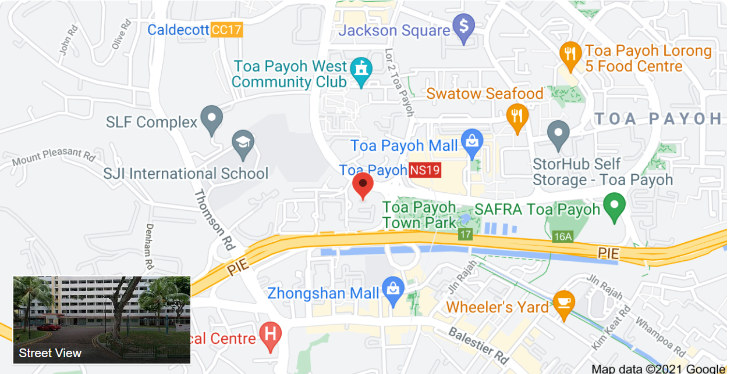
Never Forget™
Home
Create
Update
Current Home
Hide Picture
Delete Memory
Memories
Blk 155 Toa Payoh #05-156
My current home
Current Home
James – Eldest Son home
Samuel – Eldest Grandson
Julia – Youngest Granddaughter

Slide 5
Never Forget™
Home
Create
Update
Memory
Current Home
Description
Choose Memory Picture
Blk 155 Toa Payoh #05-156
My current home
Submit Memory

Slide 6
Never Forget™
Home
Create
Update
Memory
Current Home
Memories
Current Home
James – Eldest Son home
Samuel – Eldest Grandson
Julia – Youngest Granddaughter
Description
Choose Memory Picture
Blk 155 Toa Payoh #05-156
My current home
Submit Memory

Slide 7

Never Forget™ Version 1.0 – Video demonstration

Slide 8
Project Reflections
What have I learned
Have learnt to create interactive webpage using HTML, CSS, JS, PHP and MySQL
Understood the DOM model and application of CRUD – Create, Read, Update and Delete of databases
Also appreciate and able to use some of the website creation tools/ Framework like Bootstrap, Laravel and JQuery
What are interesting to find out more
I am interested to find out more on data, message and control passing for distributed monitoring and control system. Developing and Linking the front end and back end of a web base application
Why I learnt all this
To be able to design, develop and manage distributed monitor and control applications using web browsers as the UI.

Slide 9
Thank You

